Slide 1
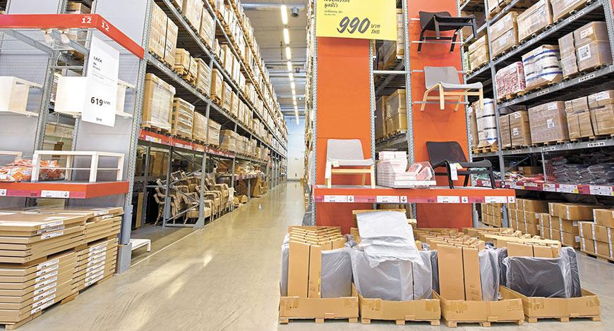
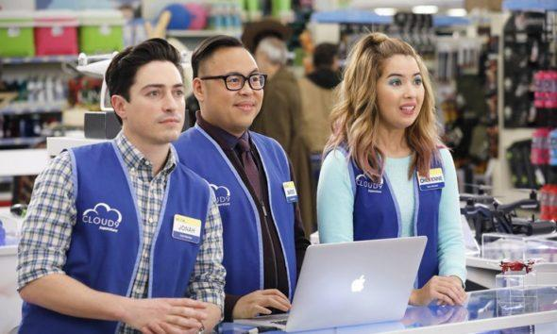
CRM Analytics on Superstore Dataset
Dhiman Sarkar
MS Business Analytics ’21
Loyola Marymount University
Los Angeles, CA
Notes:
Welcome to all our new marketing and sales representatives for the training seminar this evening. Today Harry, Max, Stu and I are going to walk you through some of our business insights and unique sales techniques.

Slide 2

Agenda
The Customer
The Product
Visual Pointers
Cross-Selling
Strengths, Problems, Recommendations
Notes:
Our Agenda for this presentation would be to understand the customer along their background and their purchasing habits. Identify the products that are most popular and generate high revenue. Take a look at some visualizations and understand the patterns in our data. Followed by analyzing the products that are purchased in relation to other items and devise a plan to promote cross-selling. Lastly, discuss some of the strengths, problems and the recommendations for the business.

Slide 3

The Customer
Understanding our most valuable customers
Where are they?
Market
Country
What are they buying?
Product Category
Sub Category
Notes:
Group Presentation Guidance
Typically group case presentations should have no more than 20 slides (15 minutes presentation+2 minutes Q&A) and flow in the following order:
Overview of the report & group introduction 1 slide
Story block 1 3 slides
Story block 2 3 slides
Story block 3 3 slides
Story block 4 3 slides
Overall strengths of the business 1-2 slides
Problems and Possible solutions 1-2 slides
Recommendations 1-2 slide
learning points of the project 1 slide
Your styles should be:
Visual based
No full sentences
No more than 5 words in one bullet point
No more than 5 points per slide
Engaging your audience
Competition is on!!! Think about how to be unique, different, and insightful that other groups might NOT be able to match… The winning group voted by the class will get extra-credits!

Slide 4

Where are they?
(Country)
16.9% in the United States
5.0% in the France
4.9% in Australia
4.6% in Mexico
4.5% in the United Kingdom
Notes:
Group Presentation Guidance
Typically group case presentations should have no more than 20 slides (15 minutes presentation+2 minutes Q&A) and flow in the following order:
Overview of the report & group introduction 1 slide
Story block 1 3 slides
Story block 2 3 slides
Story block 3 3 slides
Story block 4 3 slides
Overall strengths of the business 1-2 slides
Problems and Possible solutions 1-2 slides
Recommendations 1-2 slide
learning points of the project 1 slide
Your styles should be:
Visual based
No full sentences
No more than 5 words in one bullet point
No more than 5 points per slide
Engaging your audience
Competition is on!!! Think about how to be unique, different, and insightful that other groups might NOT be able to match… The winning group voted by the class will get extra-credits!

Slide 5

Where are they?
(Market)
18.2% in the European Union
16.9% in the United States
16.4% in the Asia Pacific
14.3% in Latin America
Notes:
Group Presentation Guidance
Typically group case presentations should have no more than 20 slides (15 minutes presentation+2 minutes Q&A) and flow in the following order:
Overview of the report & group introduction 1 slide
Story block 1 3 slides
Story block 2 3 slides
Story block 3 3 slides
Story block 4 3 slides
Overall strengths of the business 1-2 slides
Problems and Possible solutions 1-2 slides
Recommendations 1-2 slide
learning points of the project 1 slide
Your styles should be:
Visual based
No full sentences
No more than 5 words in one bullet point
No more than 5 points per slide
Engaging your audience
Competition is on!!! Think about how to be unique, different, and insightful that other groups might NOT be able to match… The winning group voted by the class will get extra-credits!

Slide 6
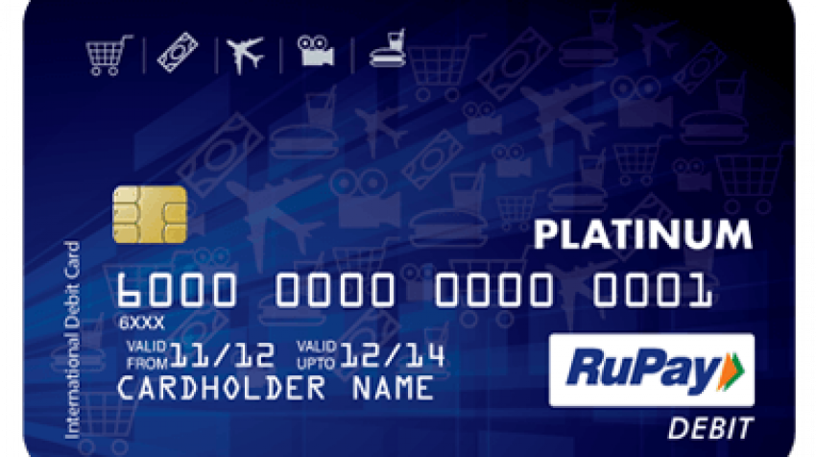
What are they buying?
Product Category
60% Office Supplies
20% Technology
20% Furniture
Notes:
Group Presentation Guidance
Typically group case presentations should have no more than 20 slides (15 minutes presentation+2 minutes Q&A) and flow in the following order:
Overview of the report & group introduction 1 slide
Story block 1 3 slides
Story block 2 3 slides
Story block 3 3 slides
Story block 4 3 slides
Overall strengths of the business 1-2 slides
Problems and Possible solutions 1-2 slides
Recommendations 1-2 slide
learning points of the project 1 slide
Your styles should be:
Visual based
No full sentences
No more than 5 words in one bullet point
No more than 5 points per slide
Engaging your audience
Competition is on!!! Think about how to be unique, different, and insightful that other groups might NOT be able to match… The winning group voted by the class will get extra-credits!

Slide 7
What are they buying?
Subcategories
12.6% Binders
10.8% Art
9.5% Storage
6.8% Accessories
6.8% Chairs
Notes:
Group Presentation Guidance
Typically group case presentations should have no more than 20 slides (15 minutes presentation+2 minutes Q&A) and flow in the following order:
Overview of the report & group introduction 1 slide
Story block 1 3 slides
Story block 2 3 slides
Story block 3 3 slides
Story block 4 3 slides
Overall strengths of the business 1-2 slides
Problems and Possible solutions 1-2 slides
Recommendations 1-2 slide
learning points of the project 1 slide
Your styles should be:
Visual based
No full sentences
No more than 5 words in one bullet point
No more than 5 points per slide
Engaging your audience
Competition is on!!! Think about how to be unique, different, and insightful that other groups might NOT be able to match… The winning group voted by the class will get extra-credits!

Slide 8
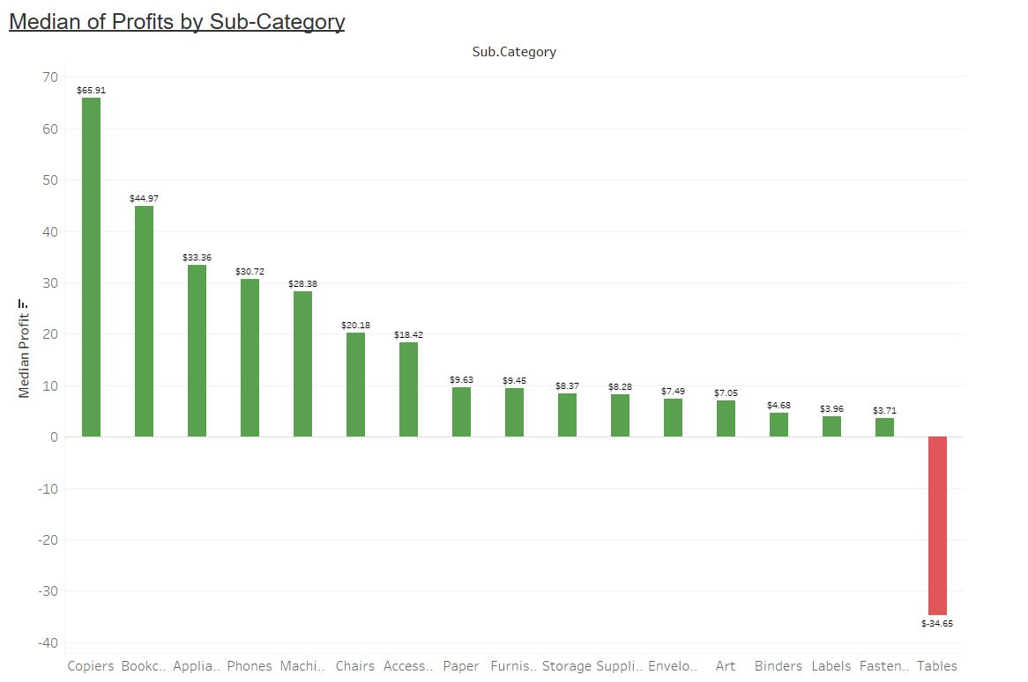
The Product Perspective
Highest Median Profit:
Category: Technology
Subcategory: Copiers
Product: Canon ImageClass 2200 Copier
Disconnect between Sales and Profit
Notes:
Now that we have looked at what our best customers look like, let’s take a look at sales and profit from the product perspective. Let’s look at our highest performers based on median profit. Tech is our most profitable Category by median with $29.90 per order. Our most profitable sub-Category is Copiers, with a median profit of $65.90. And, as we would expect, a copier is our highest median profit product.
However, we have a disconnect. None of our most profitable category, subcategory, or product are top sellers. In fact, the Tech category is the category with the lowest sales. Similarly, because they are expensive, Copiers are not sold often. The categories that have the lowest profit margins are often those with the most sales.
Now, let’s take a look at some factors that can drive sales.

Slide 9

Sales and Profit Drivers
Sales and Profit Drivers:
Discount
Sub-Category
Quantity
Location
Notes:
We all know that profit is driven by sales, but what are some of the other factors that can drive sales, and in turn profit. Discount is one factor which can drive sales, but also reduces profits. However, we will show how discounts can be used to generate profit later on. Another factor that can increase the dollar value of a sale and profitability is the sub-Category or specific product you are selling. For example, Copiers and Appliances drive the dollar value of a sale more than Fasteners would.
Quantity is another factor that can affect the sale’s value and profitability. It amplifies the effect of whatever product you are selling. Quantity can increase the profitability or losses caused by a sale.
Finally, where you are selling from or the location of your customer can increase or decrease the dollar value of a sale.

Slide 10
Audience Question
What other factors could influence sales and profit?
Type in chat!
Notes:
Now we have a quick question for you all. Could you please type in the chat other factors you think may influence sales and profit?

Slide 11

Seasonality?
Are Sales and Profits Seasonal?
We tested:
Day of Week
Month of Year
No Seasonal Differences
Notes:
Many of our trainees are concerned about seasonality. We also wanted to see if sales and profits are seasonally driven. We tested for sales and profit differences caused by day of the week, for example a weekend rush. And we tested for sales and profits differences by month of the year. However, we did not find seasonal differences for either day of the week or month of the year.

Slide 12
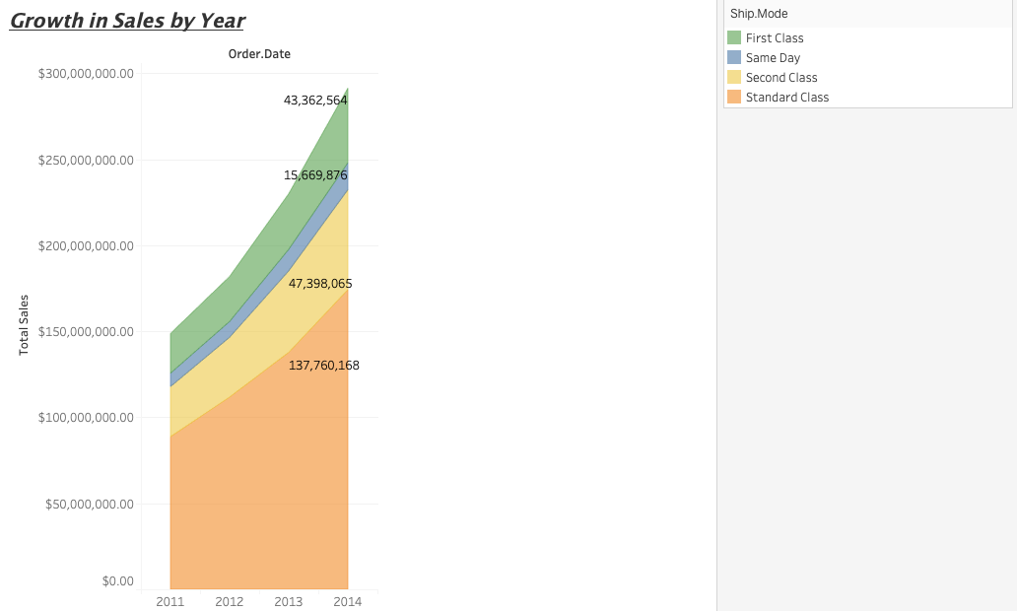
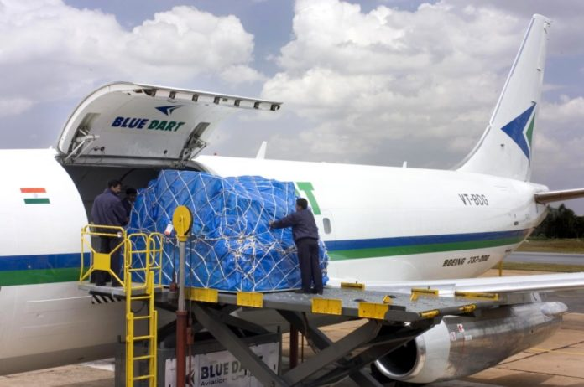
Growth in Sales Via Shipping
Steady Increase Across all Shipping Modes
Standard Class Shipping having highest amount of sales ($137,760,168)
Followed by Second Class Raking $47,398,065 in 2014
Other two shipping modes consists of First Class ($43,362,564) and Same Day shipping ($15,669,876).
Notes:
Now let's take a look and analyze a few visualizations. In the area graph for growth in sales by year, we can see a steady increase in the total sales across all the shipping modes and for the years 2011 to 2014. The standard class shipping constitutes the highest amount of sales across the entire spectrum. It has a staggering sales of $137,760,168 in the year 2014. The next big segment is constituted by second class with $47,398,065 in the year 2014, followed by first class and same day with $43,362,564 and $15,669,876 in the year 2014 respectively.

Slide 13
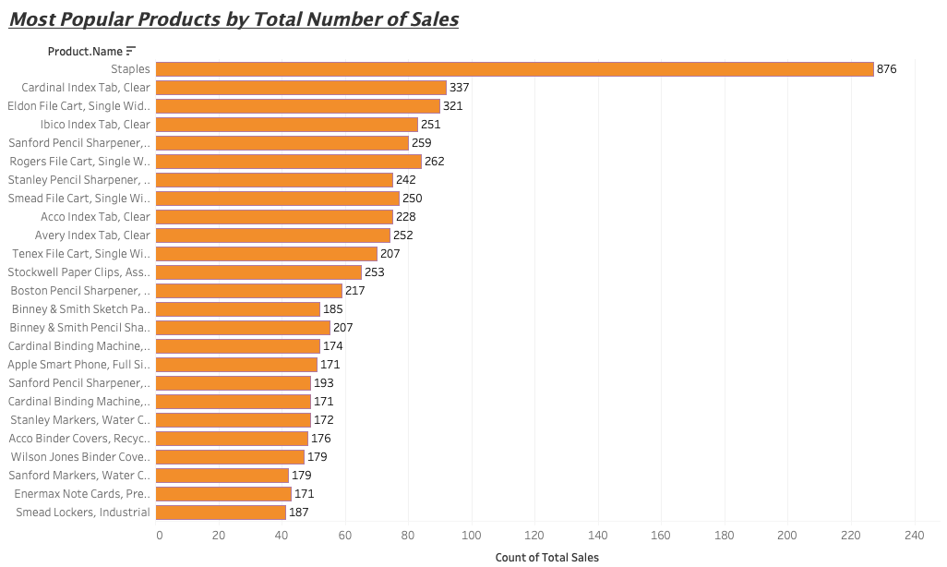
Most Popular Products
Staples is the most popular item at the store selling a total of 876 units
Huge difference in the numbers of item one and item two
Showcases the high demand and the popularity of the stapes
Next two most popular items include
Cardinal index,Tab,Calear with count of 337 units
Eldon File Cart, Single Width with count of 321 units
Notes:
This visualization of the horizontal bar graph showcases the most popular products by the total number of sales. By the statistics, we can see that Staples is the most popular item at the store, selling a total of 876 units. There is a huge difference in the numbers for item one and item two, by which we can estimate the high demand and the popularity of the staples. The number two and three most popular products are of the Cardinal Index Tab & Clear with 337 units solds; and Eldon File Cart & Single Width with 321 units sold.

Slide 14
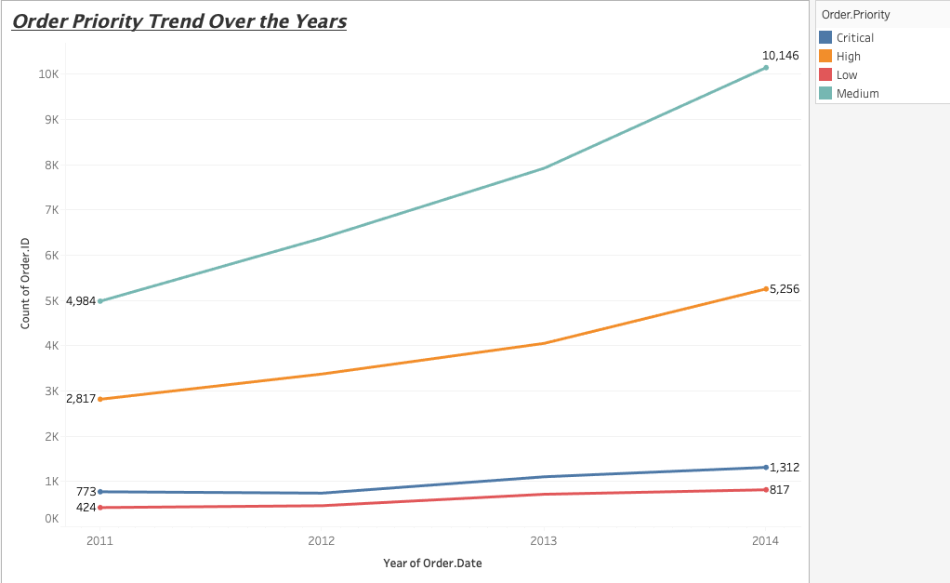
Analyzing the Order Priority Trendline
Priority trendline depicts the rise in the order priority trend (2011-2014)
A steady rise in the orders across all the priority segments
Biggest jump was witnessed for the medium priority orders (4,984 to 10,146)
High priority order showing progression from 2,817 to 5,256
Critical and Low priority orders remain relatively low
Notes:
The order priority trendline depicts the rise in the order priority trend from the year 2011 - 2015. Each and every type of order priority has seen a rise in the number of orders over the years. Out of which the highest jump was witnessed for the medium priority orders, where it showed a rise from 4,984 to 10,146 followed by high priority order, showing progression from 2,817 to 5,256 over the years. The critical and low priority orders remain low as compared to the other two.

Slide 15

Market Basket Analysis
•Pricing strategies
•Product placement
•Cross-selling strategies
Notes:
We conducted a Market Basket Analysis
→ and based on the insights we will give knowledge-based recommendations about items and their specific relationships
(*First of all, we prepared the data and created a smaller DF with only required columns "Order.ID" and "Sub.Category because we don’t care about all the other customer data for this particular analysis.*
→ Convert it to a transactional format )

Slide 16
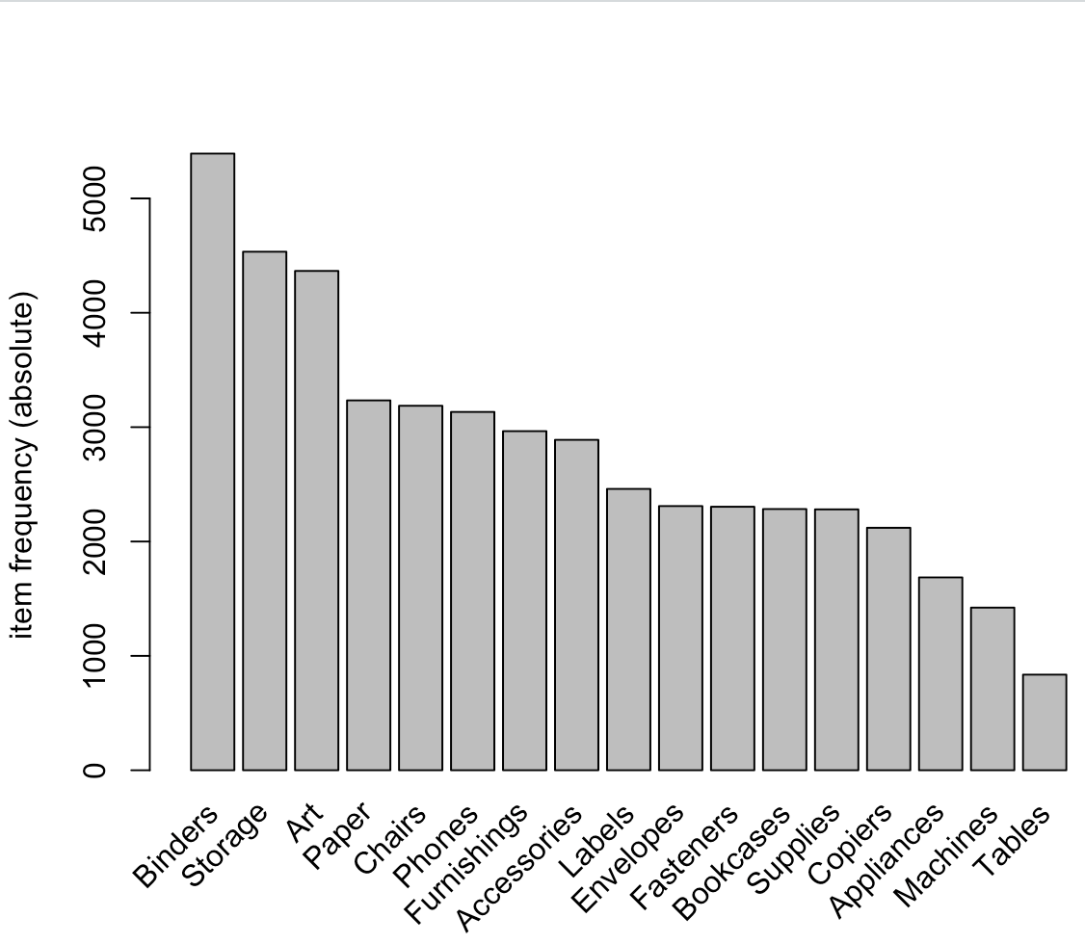
Market Basket Analysis
Frequency Plot:
Notes:
First we explored the data before we make any rules:
We find out that we have 17 unique sub-categories
And by creating a frequency plot → we discovered that Binders are the most frequently bought product followed by Storage and Art
Recommendation:
Product Placement strategy for the sales manager could be to place the most popular products (e.g. Binders) in the furthest area of the store so that shoppers see themselves obligated to walk all the way through the store and possibly add non-planned items in their cart
By tempting the customer to buy other products along the way
→ increase overall revenue
Now Question to the audience:
Taking the customers perspective. Do you think walking to the furthest area of the store to get the product you were looking for will increase or decrease customer satisfaction ?

Slide 17


Audience Question:
Taking the customers perspective
Do you think walking to the furthest area of the store to get the product you were looking for will increase or decrease customer satisfaction ?
Vs
Increase
Decrease
Notes:
Now Question to the audience:
Taking the customers perspective. Do you think walking to the furthest area of the store to get the product you were looking for will increase or decrease customer satisfaction ?

Slide 18
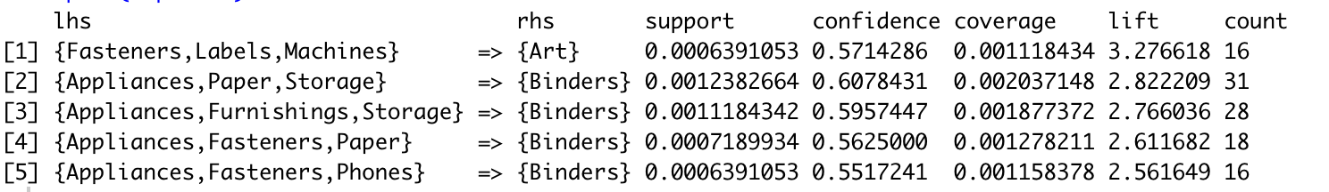
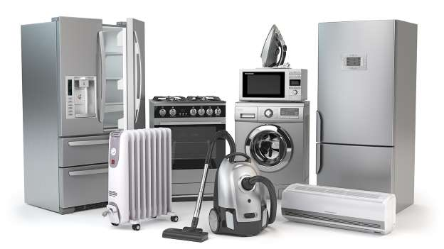
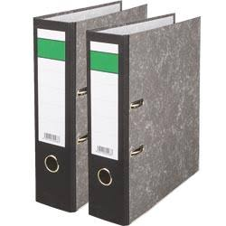
Market Basket Analysis
Appliances and Binders:
Strong relationship
Notes:
After some further analysis and tweaking of the three important ratios/parameters: support, confidence and lift we found some initial rules and sorted the top 5 by lift which represents the increase in probability. We sorted by lift because we want the salespeople to push products/product sets that will increase the % chance of buying another product.
By inspecting the rules we discovered 4 out of 5 top rules show a strong relationship between appliances and Binders.
Recommendation:
Manage the placement of goods in their store layout so that related products (Appliances and Binders ) are placed together in such a manner that customers can logically find items he/she might buy…. And a sales assistant close by to educate the customers about those product , which increases the customer satisfaction and hence the profit.

Slide 19
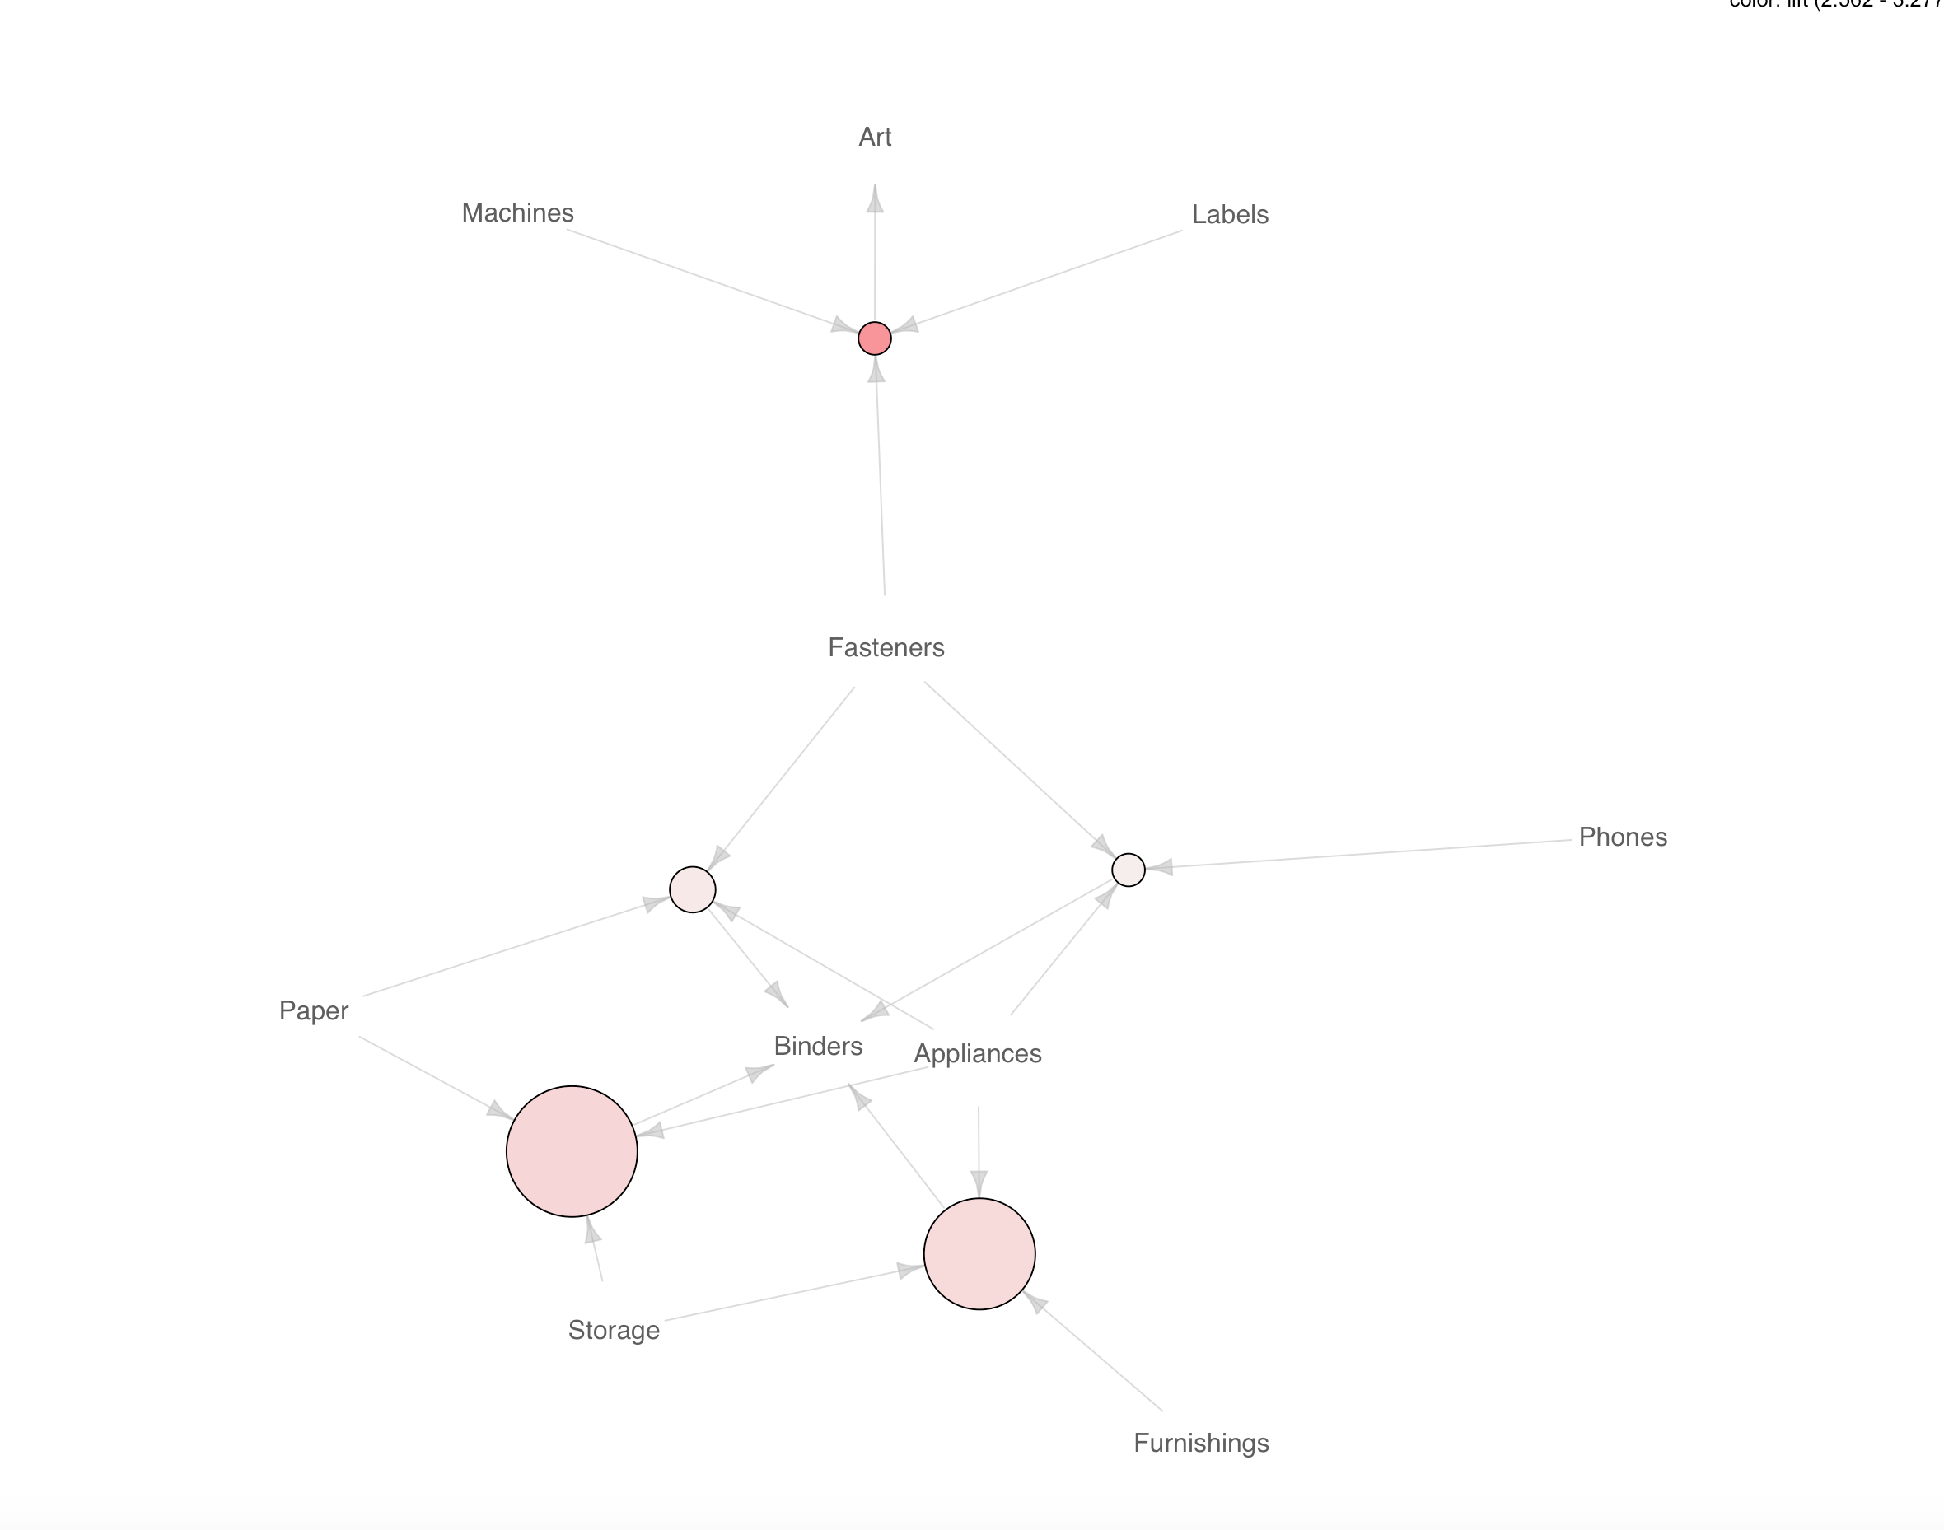
Market Basket Analysis
Notes:
Lastly, we used the visualization and mapped the top 5 rules in a graph.
→ to derive pricing strategies in terms of discounts to encourage larger basket sales:
In the top:
Circle with darker color → higher lift
We can see the relationship ….. if someone buys (Fasteners,Labels, Machines), it often times leads to purchase of Art.
From inspecting the rules more in depth we know they are 57% likely to buy Art.
Recommendation:
Offer discounts on Fasteners because they bring the least profit → this pricing strategy will
to encourage basket sales of products yielding higher profit margins overall.
The bottom left:
Biggest circle --> most frequently purchased set of items , which shows the relationship between
{Appliances,Paper,Storage} => {Binders} --> *(most frequent observation/transaction*
Storage least profitable sub-categroy --> offer discount
but relationship not as strong…. Thus the brighter color of the circle.

Slide 20
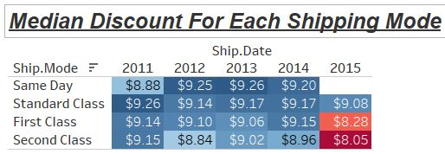
Current Strengths
Access to wide market
Global Presence
Consistent Total Sales Growth
Decrease in Shipping Discounts
Customers willing to pay
Notes:
Although all of this new information may feel overwhelming, let’s remind ourselves of the strengths of our company. Currently, we have access to a global market.
We have also had consistent total sales growth for the past four years. We have grown from $150,000,000 in sales in 2011 to nearly $300,000,000 today.
Finally, we have consistently decreased the discount we have had to offer on shipping. This means that the customers are more willing to pay premium prices for our products. --Max

Slide 21

Potential Problems
Issues Converting Sales to Profit
Products to Push?
When to Cross-Sell?
Customer Relationships?
Notes:
Now let’s look at potential problems that may arise while you are a manager. The first potential problem is that you are reaching your sales target, but not your profit target. The solution to this comes from understanding that the drivers of sales are not always the same as the drivers for profit. Instead of pushing for a general type of product, it may be effective to encourage your salespeople to push a specific product that both serves the customer’s need and is profitable.
Another issue you may face as a manager is deciding when to cross-sell and when to encourage your employees to cross sell. The most effective way to cross-sell is to establish rules for which products you should encourage a customer to purchase. Also you may want to discount the least expensive item you plan on using when cross-selling.
Another potential issue you may face as a manager is deciding when to form a stronger relationship with a specific customer. If the customer has a membership at the store, it may be worthwhile to find the customer’s lifetime value. If it is within the top 20% of the customer base, it will be worthwhile to strengthen the relationship.

Slide 22
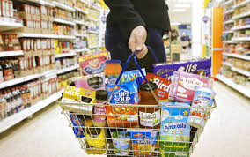
Recommendations
Phase-out Unprofitable Products
Discount to Encourage Basket Sales
Place Basket Items Near Each Other
Maintain and Strengthen Profitable Relationships
Notes:
Now that we have discussed potential problems and solutions, let’s take a look at some more general recommendations.
In order to avoid confusion over which products to push and to prevent salesperson mistakes. We recommend that managers phase out unprofitable products from their locations.
We also recommend that managers encourage basket-selling or cross selling by discounting the least expensive item in the bundle. For example, we would discount the Fasteners product Subcategory.
Another effective way to encourage cross-selling is to place items that appear in the same basket near each other in the store. For example, we would place Binders near Appliances to encourage binder sales.
We also recommend cultivating and maintaining relationships with your most profitable customers. -Stu

Slide 23

Learning Points of Project
Identify the CLV through recency-frequency-monetary analysis
Understand the purchasing behaviors of the customers by market basket analysis for trends
Use Regression to identify important factors
Utilize visualizations to group different variables and understand visual patterns
Provide key recommendations based on our analysis
Notes:
Through this project we were able to take away some key learning points which enabled us to:
Identify the Customer-Lifetime-Value through recency-frequency-monetary analysis
Understand the purchasing behaviors of the customers by market basket analysis for trends
Use Regression to identify important factors
Utilize visualizations to group different variables and understand visual patterns
Provide key recommendations based on our analysis

Slide 24
Thank You!
Questions?
Notes:
Thank You for attending this training session. Feel free to ask questions.

